Slide 1
Django
Session-9

Slide 2
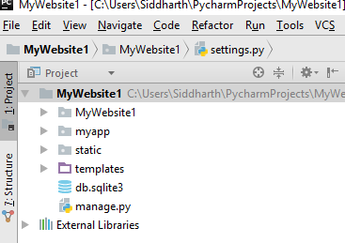
Folder Arrangement

Slide 3
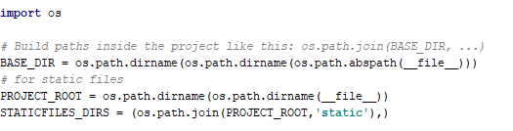
Settings.py
# for static files PROJECT_ROOT = os.path.dirname(os.path.dirname(__file__)) STATICFILES_DIRS = (os.path.join(PROJECT_ROOT,'static'),)

Slide 4
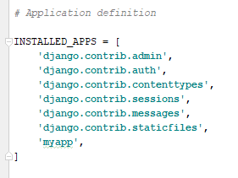
Settings.py

Slide 5
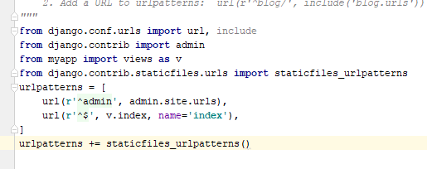
Urls.py
from django.conf.urls import url, include from django.contrib import admin from myapp import views as v from django.contrib.staticfiles.urls import staticfiles_urlpatterns urlpatterns = [ url(r'^admin', admin.site.urls), url(r'^$', v.index, name='index'), ] urlpatterns += staticfiles_urlpatterns()

Slide 6
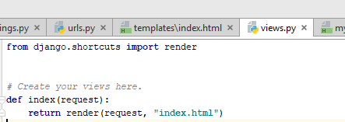
Views.py

Slide 7
Index.html
{% load staticfiles %}
Add this as the first line of
Your HTML file(above Doctype)

Slide 8
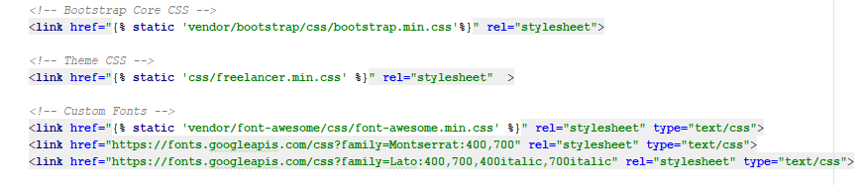
Changes to CSS in index.html file
Code:
<link href="{% static 'css/freelancer.min.css' %}" rel="stylesheet" >

Slide 9
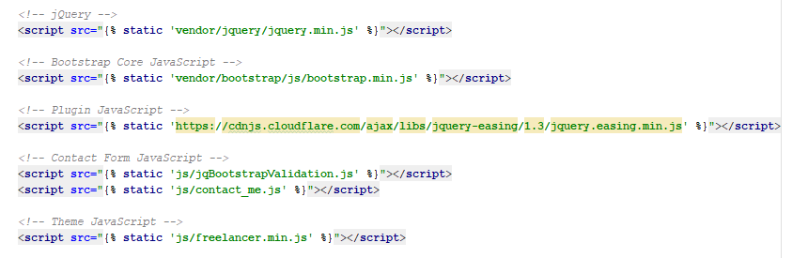
Index.html →javascript

